Slide 1
AIML CA2 Time Series
Done By: Darius (2222259)

Slide 2
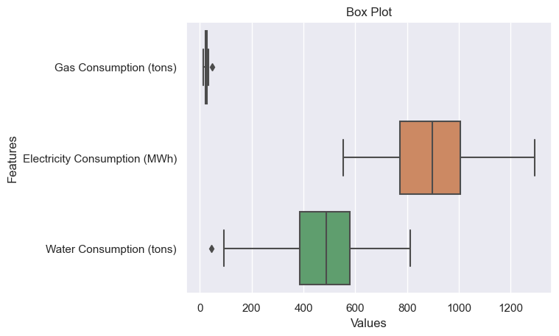
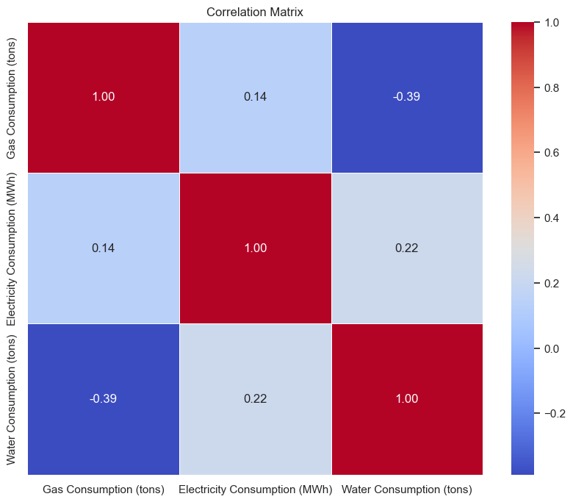
EDA
Box plot
Correlation
Usually, a box plot is used to get a rough idea of the outliers and the range of the values, however in the case of time series we can’t use it as an accurate indicator for outliers
As we can see from the correlation it looks generally quite good with no features really being highly correlated to one another

Slide 3
02
Time Series Analysis

Slide 4
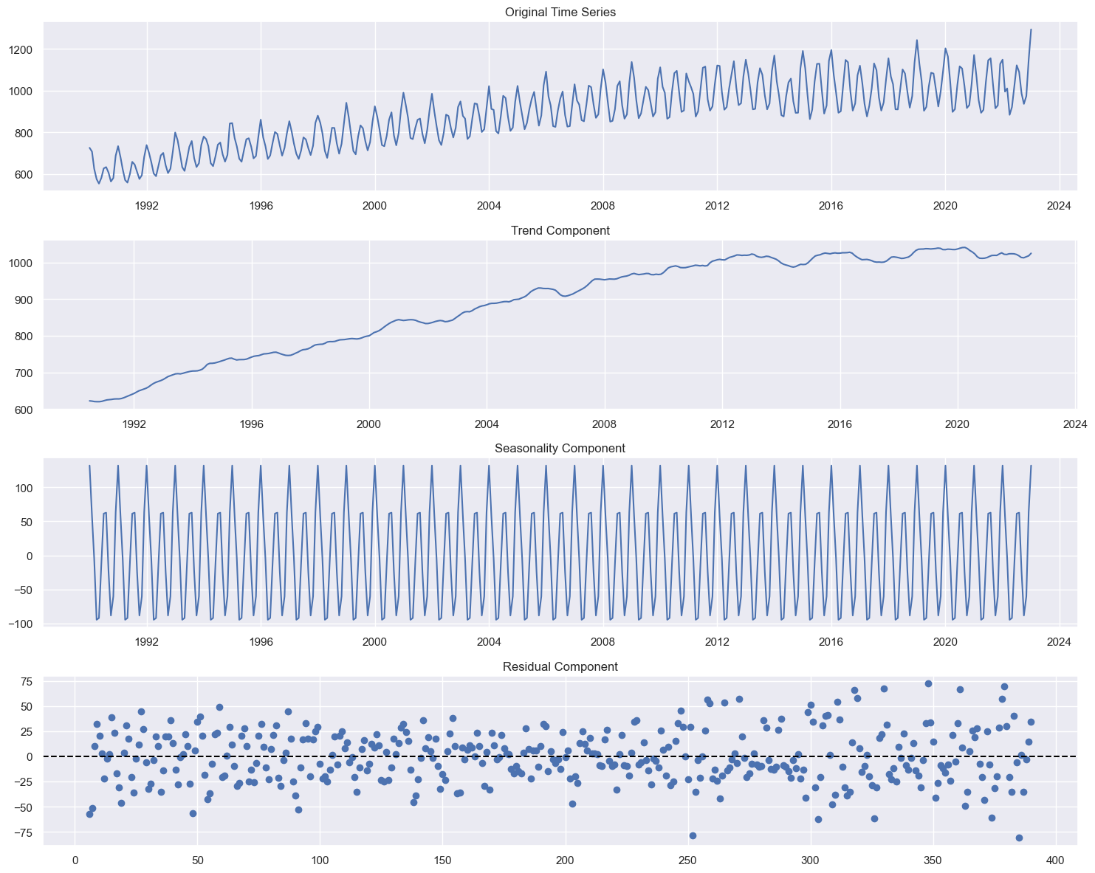
Time Series Analysis
Electricity Decomposition
Let's take a look at each part of the decomposition
Trend: For electricity we can see a clear upward linear trend
Seasonality: We can see clear signs of seasonality as well, after displaying the output I can see each season contains 12 datapoints = 12 months = 1 year
Residual: Through the box plot we saw only 1 outlier, however from residual plot we can see more than 1 more than one point that is an anomaly

Slide 5
03
Test Before Forecast

Slide 6
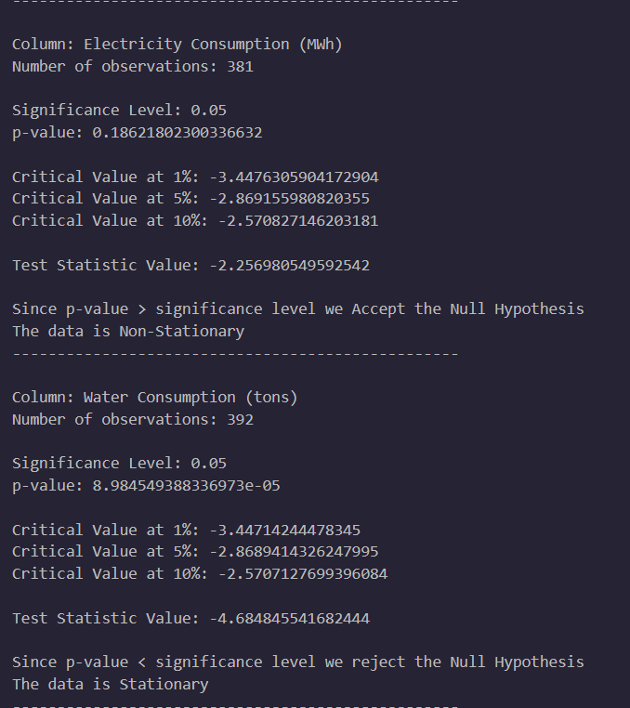
Test (Stationarity Test)
Dicky Fuller Test
Insights I got from this
Gas Consumption = Stationary
Electricity Consumption = Non-Stationary
Water Consumption = Stationary

Slide 7
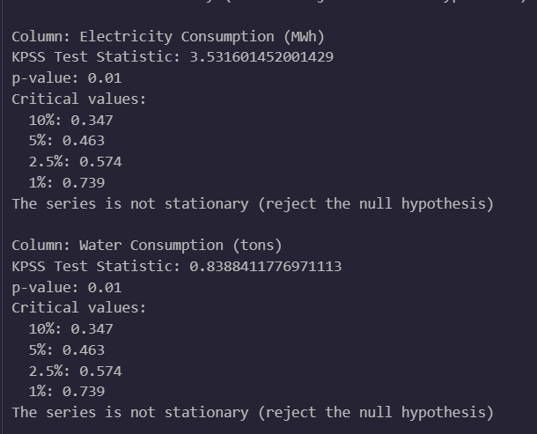
Test (Stationarity Test)
KPSS Test
Insights I got from this
Gas Consumption = Stationary
Electricity Consumption = Non - Stationary
Water Consumption = Non – Stationary
What do I do about Water
• In Dicky Fuller Test Water is Stationary
• In KPSS Test Water is Non - Stationary
Conclusion: assume Non - Stationary

Slide 8
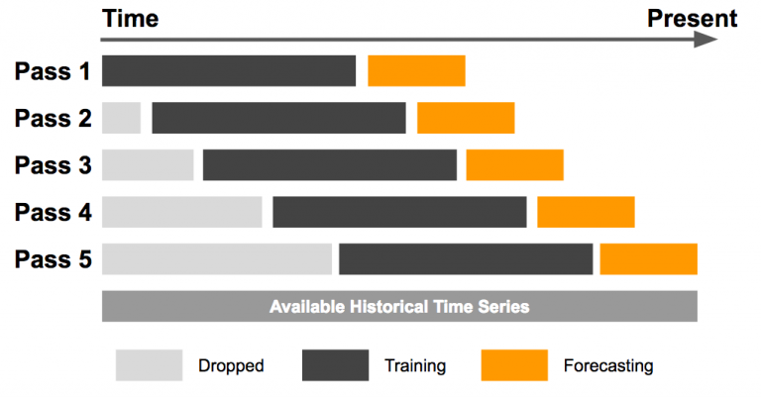
Test (Outlier/Anomaly Detection)
Sliding Window Basis
When evaluating Outliers, We can just take the whole time series data and decide on which is the extreme value like a box plot, Lets use an example to explain this
1992/2/31 I want to know if this point is an outlier
Whether this point is a outlier or not, I can use future data to evaluate it, so I can’t use 1993/2/31’s value to decide whether that point is extreme or not I can only use past values
Which is where Sliding Window comes in evaluating whether a datapoint is an outlier or not?

Slide 9
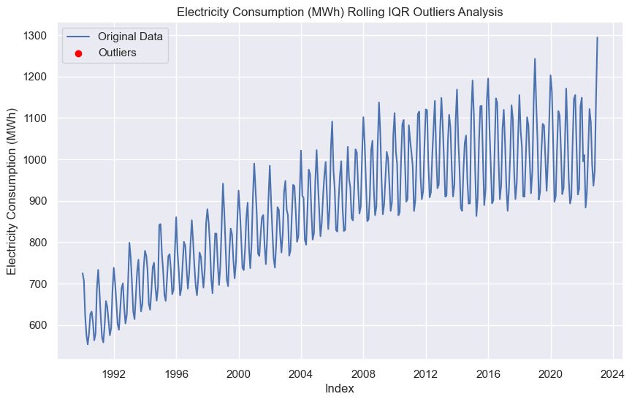
Test (Outlier/Anomaly Detection)
Electricity Consumption
The Sliding Window seems to work as theorized
Even though the data looks like it has a lot of anomaly points, when evaluating bit by bit only using the past values it should not have any outliers, which is exactly what happens

Slide 10
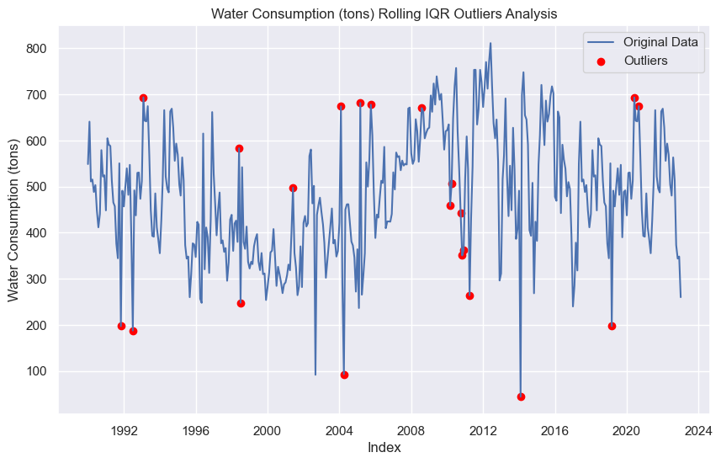
Test (Outlier/Anomaly Detection)
Water Consumption
Similarly, this anomaly/outlier detection works as theorized for this where the anomalies are only marked as so if they are extremely significant compared to recent past data points, which is exactly what we observed here

Slide 11
04
Baseline Model

Slide 12
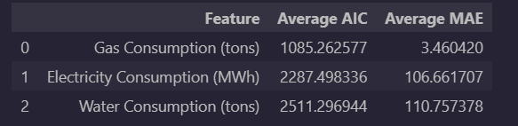
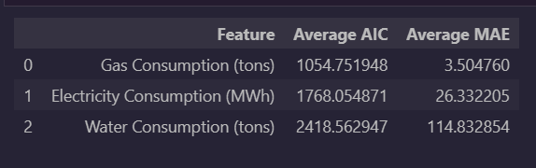



Test (ACF and PACF Analysis)
ARIMA
SARIMA
Exponential Smoothing
Gas Consumption
Electricity Consumption
Water Consumption

Slide 13
05
Hyperparameter Tuning

Slide 14
Hyperparameter Tuning
ARIMA
SARIMA
Exponential Smoothing
ARIMA parameters that I need to tune:
Normal Order (p,d,q)
I tuned the 3 parameters, but the results for each feature didn’t really improve
SARIMA parameters that I need to tune:
Seasonal Order (P,D,Q)
To quicken the process, the normal order (p,d,q) will be taken from the optimal ARIMA parameters
Still better compared to ARIMA
Exponential Smoothing was already the best at baseline comparison, we just need to optimize it by tuning:
Alpha (smoothing Level)
Beta (Smoothing Slope)
Gamma (Damping Level)
Those are the only parameters, that I can tune

Slide 15
05
Final Model

Slide 16
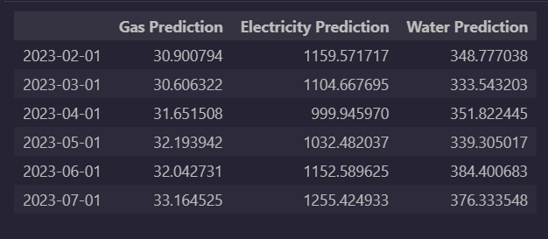
Final Model
Exponential Smoothing
While comparing all the scores, that I get after tuning, Exponential Smoothing was better than all other models for all the features, hence I forecasted the next 6 months using exponential smoothing

Slide 17
Thanks
Do you have any questions?
addyouremail@freepik.com
+91 620 421 838
yourwebsite.com
Please keep this slide for attribution

